Slide 1

Predicting and Mitigating Car Accident Severity
BY : ALYSSA HEARE

Slide 2

Abstract
The following study was conducted to analyze car accident severity. The United States has a high accident rate and the severity of such accidents can be life threating. The data utilized was historic data from the city of Seattle. Seattle is a growing city, which still has a large vehicle travel sector and yet similar infrastructure to other cities across the United States, making it a feasible chose for this study. The study’s data was manipulated and analyzed for indications of what caused such severity and if severity level could be predicted using machine learning tools such as classification methodology to diminish such accidents. This study provided insight as to the causes of higher severity and accident levels and recommended actions that could be taken based on the projections and examined data.

Slide 3
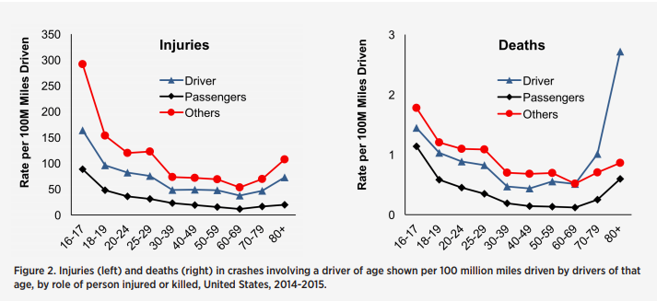
INTRO:
In 2018, the NHTSA has reported there were less than 40,000 traffic related deaths. The NHTSA also reported over 2.7 million accidents where individuals sustained road related injuries! Can there be a way to reduce or avoid such accidents, or reduce the severity of the accidents that are occurring?

Slide 4
DATA INFORMATION
The original dataset from the Seattle department of transportation was studied and analyzed for various factors which could provide insight to traffic accident severity and predicting what factors could mitigate such injuries.

Slide 5
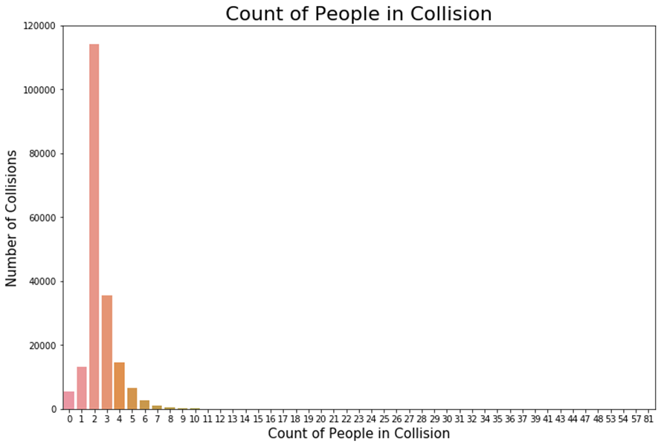
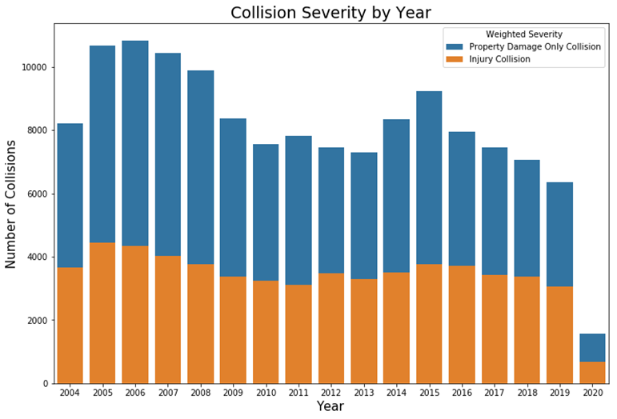
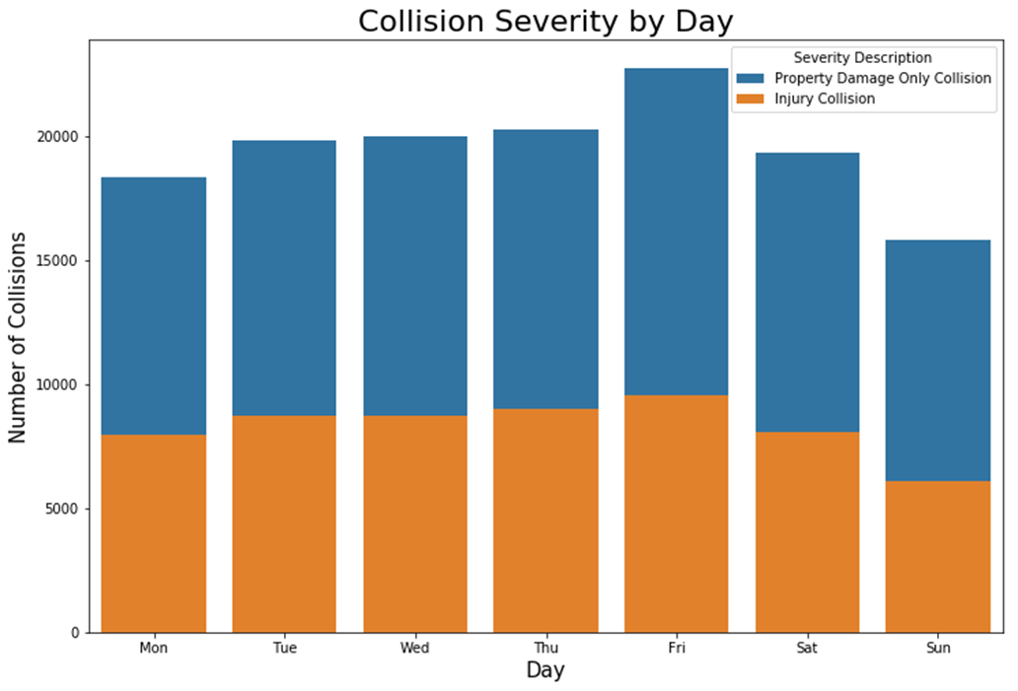
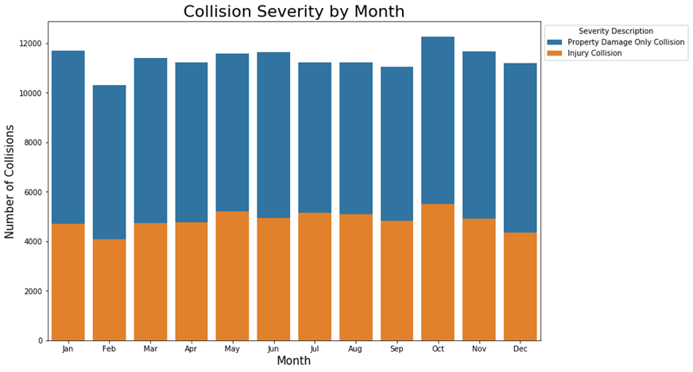
Examples of Omitted data due to similarity = year, month , day, number of involved .

Slide 6
DATA INFORMATION THAT WAS CONSIDERED TO BE MEANINGFUL AND VALID

Slide 7
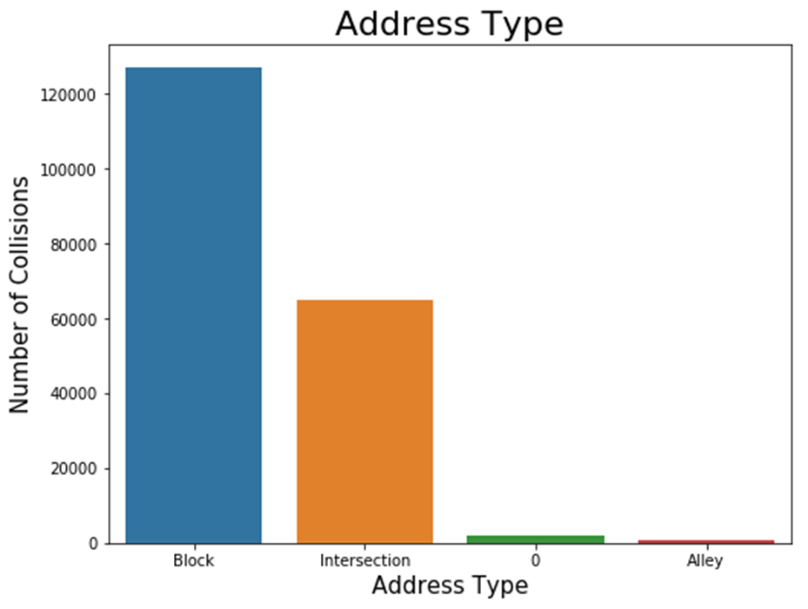
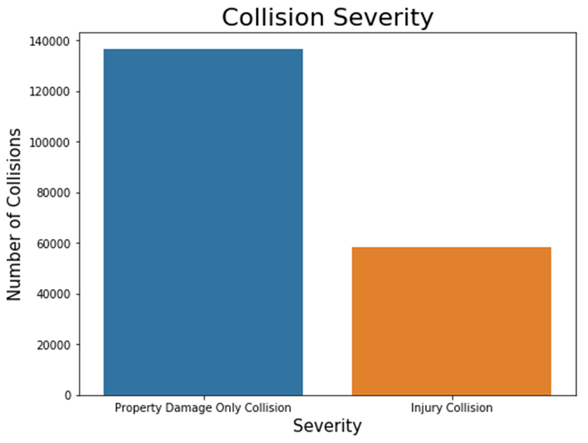
DATA DESCRIPTIONS GRAPHED:

Slide 8
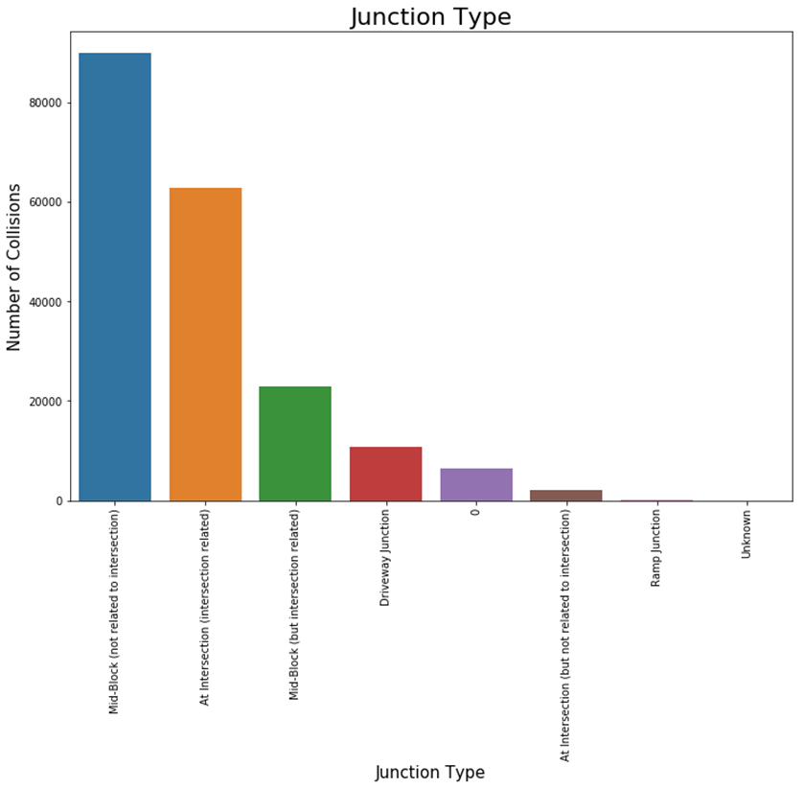
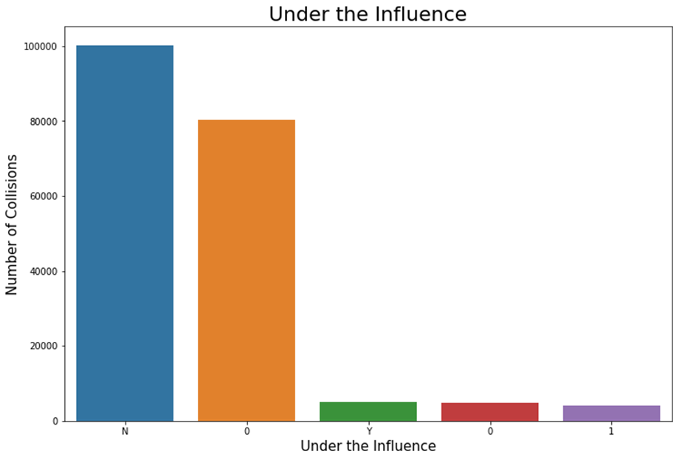
DATA DESCRIPTIONS GRAPHED CONT.:

Slide 9
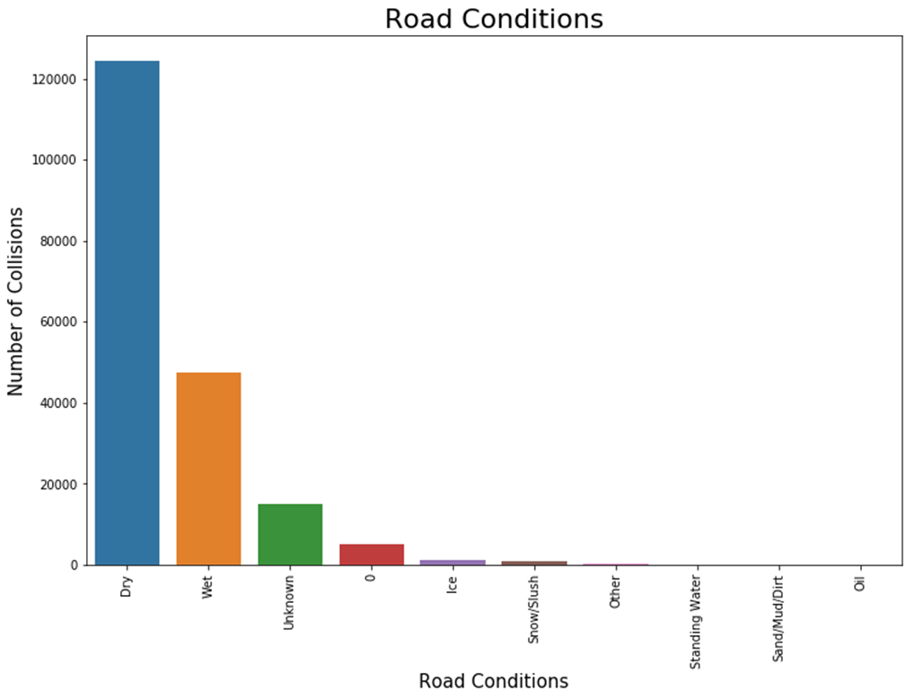
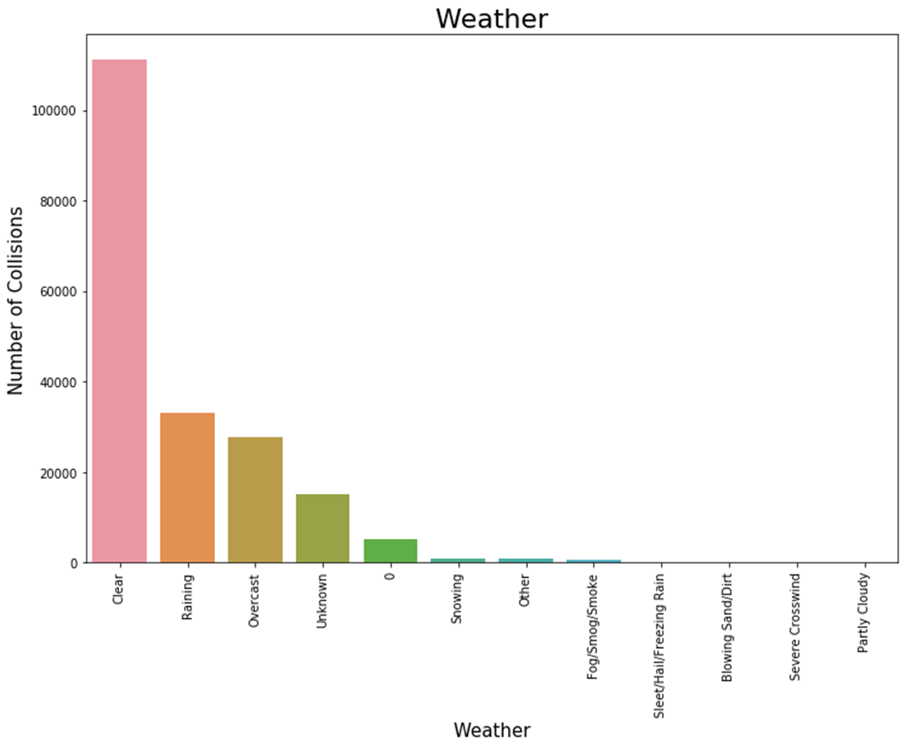
DATA DESCRIPTIONS GRAPHED CONT.:

Slide 10
DATA DESCRIPTIONS GRAPHED CONT.:

Slide 11
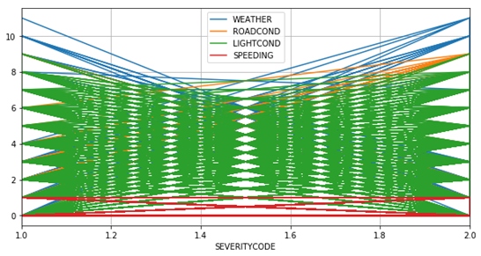
VARIABLES THAT WERE CONSIDERED
CHART SHOWS FEATURES AND THEIR OVERLAP OF IMPACT ON SEVERITY CODE---
AND CORRELATIONS
WEATHER
ROAD CONDITION
LIGHT CONDITION
SPEEDING

Slide 12
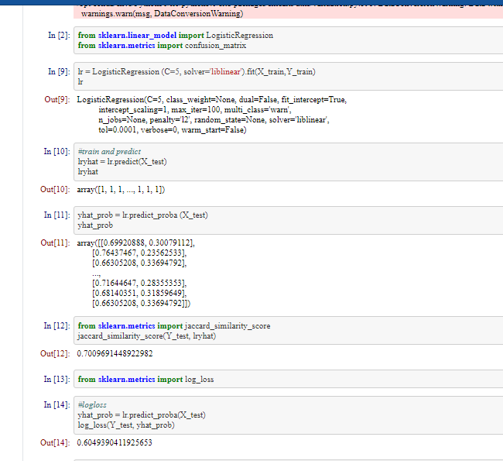
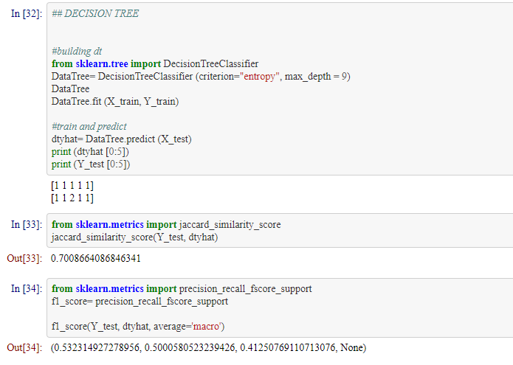
Machine learning tools were used:
First Decision tree modeling THEN Logistic Regression both classifying models.

Slide 13
BOTH showed valid results.
Decision Tree results.
Logistic Reg. Results

Slide 14
Data observations:
1. More injuries involving prop. Damage vs. Injury
2. Collisions happened in or near downtown or highway
3. Collisions without injury are well distributed.
4. Most common persons involved is 2
5. Rare for pedestrians to be involved
6. More collisions happen on Friday, least on Sunday- with the average accidents per day being very similar to the same.
7. More collisions happen in October and less in Dec, but average accidents per month were very similar to the same.
8. Clear weather caused more occurrences of collisions with rainy days being the second highest.
9. Dry road conditions showed to be more prevalent to road accidents then wet.
10. Speeding accounted for main reason for collisions, along with carelessness and most likely poor infrastructure.
Speeding, weather, road and light conditions are good features to predict collision severity.

Slide 15
Discussion :
The overall outcome of the results would suggest that on days when visibility is reduced more sever accidents were likely to take place. Although more accidents occurred on clear days the severity was less debilitating. Also, when persons are speeding the more likely the severity code was in the upper quadrant of severity.
When considering the results, it seems evident that to fix or diminish accident severity that during busy times of day mornings and late afternoons, during raining or reduced visibility all highway lanes should be open including HOV. Allowing for the less cramped lanes which can lead to collisions. Also, during those times, message boards displaying delays and speed changes would be utilized to make travelers aware of halted or slow traffic.

Slide 16
Discussion Cont:
Although the weather cannot be controlled how local and state municipalities respond to the studies results could heavily impact severity in the future. Distractions and poor infrastructure could play a very large roll in where these accidents take place. Highway expansions or investing in visual enhancements to make drivers more aware of their surroundings and traffic news could lead to less severity.
As speeding remains a major contributor a larger portion of the fatality scores, state legislation could follow recommendations to enhance fines for speeding, and/ or longer probationary or suspension time for reckless driving speeds. Considering the majority of accidents were due to rear-ending other vehicles, law enforcement could be more vigilant and visible to the public during peek times of accidents. This tactic could deter such poor behaviors such as following to close to forward vehicles, speeding, and use of distracting materials.

Slide 17
Conclusion :
Vehicular crashes can lead to many unsettling outcomes. The major contributors to crash severity range from weather conditions to driver actions: speeding or distractions. These are then most common causes of accidents examined that directly correlate with the severity outcome. There are many ways to predict how sever a crash could be that have been discussed to provide conformation as to what conditions can cause certain accidents. There are also, many recommendations that can be made to lawmakers, law enforcement, the Transportation Departments, and to individuals. To simply educate drivers and individuals is not enough as it is relatively common knowledge that those variables can clear the way for crashes to happen. There is really only one way a person can truly prevent such crashes and injuries and it is by being more aware and giving themselves a constant reminder to be cautious and obey all traffic guidelines.

Slide 18
Thank you!

